Slide 1
Web Site Design Plan Checklist
Web Design, Fall 2011
Presented by: Gabe Lambert #8

Slide 2
Step 1: Define the site’s purpose
Identify the primary and secondary goals for your Web site.
Determine the objectives necessary to meet the site’s goals.
Write a formal purpose statement for the site.

Slide 3
Step 2: Identify the Site's Target Audience
Develop a target audience profile that identifies the demographic and psychographic characteristics of audience members.
Perform a needs assessment to determine the target audiences' wants, needs, and expectations that can be satisfied by your site.

Slide 4
Step 3: Determine the Site's General Content
Determine your site's pages: home, underlying, and splash or entry pages.
Ensure that the content on your site's home page answers the visitors' who, what, and where questions.
Determine the visual identity content to be added to all pages that will brand your site.
Determine the value-added content for your pages: text, images, audio, video, animation, multimedia, and dynamically generated content.
Plan a file folder organization for your HTML and content files.

Slide 5
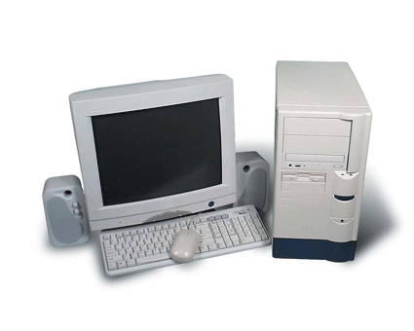
Step 4: Select the Site's Structure
Consider the best way to structure your site to achieve its purpose: linear/tutorial, random, hierarchical, or some combination of structures.
Create an outline of your site's structure: text outline, storyboard, or flowchart.

Slide 6
Step 5: Design the Look and Feel of your Site
Position visual identity and vital page content above and to the left of potential scroll lines.
Maintain visual consistency with the color scheme and page layout.
Follow WAI accessibility guidelines for the use of color.

Slide 7
Step 6: Specify the Site's Navigation System
Create a navigation system that is both user based and user controlled, offering a combination of text links; image links; navigation menus, bars, and tabs; a breadcrumb trail; a site map; and a search feature.
Maintain visual consistency with the color and page placement of navigation elements.
Perform usability testing on the navigation system during the planning and development phases.
Follow WAI accessibility guidelines for links and image maps.

