Slide 1
Global Grain and Oilseeds Trade Outlook
Dry Cargo International
Amsterdam, May 27 2008
David Walker
Edmonton, Alberta, Canada

Slide 2
Global Grain and Oilseeds Trade Outlook
Dry Cargo International
Amsterdam, May 27 2008
Disclaimer
The opinion expressed in this presentation are those of David Walker, unless cited as being of others.
While I have made every reasonable effort to ensure the information is accurate, I am unable to provide any guarantee, particularly pertaining to the future, or to be liable for the consequences of action taken on the basis of any information which is, or proves to be, inaccurate.

Slide 3
Outline
Issues
Biofuels
Food Prices
China and India
Content
24-month Review
Looking Forward
Trade Implication
A North American Perspective – US feed grains 60 percent of trade

Slide 4
24 Month Review
Pre State of the Union Address - October 2006
US Alternate Fuel Mandate
Post State of the Union Address - February 2007
Pre harvest 2008 Prospects - June 2007
Post Harvest 2008 Reality - October 2007
Non sense Season - February 2008
The Here and Now - May 2008
About rice

Slide 5
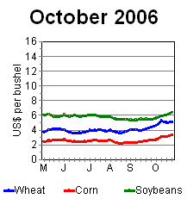
October 2006
Wheat: The impact of the drought related failure of the Australian wheat crop was becoming apparent. Both reduced global consumption and a 20% reduction in global ending stocks were being forecast.
Coarse grains: Global production was expected to decline slightly, but for a second successive year. Use was, however, forecast to increase mainly of US ethanol production.
Oilseeds: A continued expansion in global output was expected to be sufficient to keep ending stocks at record levels.
Prices, particularly for wheat, were beginning to strengthen.

Slide 6
October 2006 Global S & D’s
M tonnes Output Supply Trade Use Ending Stocks
Wheat
2005/06 (Est.) 618.9 770.3 115.3 623.1 147.2
2006/07 (Proj.)
September 596.1 742.2 110.7 615.8 126.4
October 585.1 732.4 109.0 613.1 119.3
Coarse grains
2005/06 (Est.) 974.4 1152.7 104.0 986.3 166.5
2006/07 (Proj.)
September 969.4 1136.5 104.8 1010.8 125.8
October 964.8 1131.2 105.1 1010.6 120.6
Oilseeds
2005/06 (Est.) 388.3 444.5 76.9 317.2 61.5
2006/07 (Proj.)
September 386.5 447.3 82.2 324.6 58.2
October 390.4 451.9 82.7 325.9 61.1
Source: USDA

Slide 7
US Ethanol Mandates
January 24, 2007: President George W. Bush in his “State of the Union” address noted the US:
"... must increase the supply of alternative fuels, by setting a mandatory fuels standard to require 35 billion gallons of renewable and alternative fuels in 2017 -- and that is nearly five times the current target."
At the time the US was two-third of the way to meeting the “current” 2012 target. But was using 20 percent of the US corn supply to do it. The expectation was that cellulose based ethanol production and coal gasification would be big future contributors.
December 19, 2007: The Energy Independence and Security Act was signed into law with a 2022 36 billion gallon mandate.

Slide 8
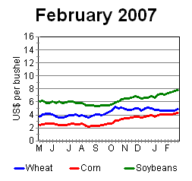
February 2007
Wheat: 2007 production was forecast to recover but wheat prospects were expected to be supported by corn markets.
Coarse Grains: A 50% increase in corn use for ethanol production was forecast and only with record acreage and yield would perspective demand be met.
Oilseeds: A switch from soybean to corn production was expected to help relieve the surplus global oilseed situation.
Prices for corn directly and soybean indirectly increased.

Slide 9
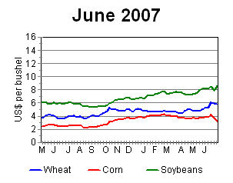
June 2007
Wheat: Global wheat production prospects began to falter beginning in eastern Europe and with them any prospects for a recovery in supplies.
Coarse Grains: The switch from soybeans and others crop exceeded expectation and a crop capable of meeting all prospective demand was in the making.
Oilseeds: Oilseed output was forecast to decline for the first time in a decade as a result of reduced US area of soybeans.
Prices for wheat, against expectations, rose while those for corn declined.

Slide 10
June 2007 Global S & D’s
M tonnes Output Supply Trade Use Ending stocks
Wheat
2006/07(Est.) 594.1 743.1 106.5 621.1 122.0
2007/08(Proj.) 610.2 732.1 107.4 620.1 112.0
Coarse grains
2006/07(Est.) 976.0 1,139.5 109.5 1,014.1 125.4
2007/08 (Proj.) 1,056.4 1,181.7 105.8 1,060.2 121.5
Oilseeds
2006/07(Est.) 404.3 468.7 82.5 329.9 71.3
2007/08(Proj.) 399.0 470.3 88.3 342.5 60.8
Source: USDA

Slide 11
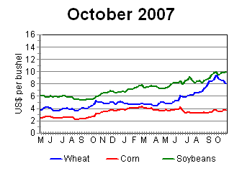
October 2007
Wheat: Crops continue to falter around the world with even the Australian crop again failing to meet expectations.
Coarse Grains: The US maize crop exceeds all expectations with near record yield off near record area. Global coarse grain markets are well supplied.
Oilseeds: Little change in the fundamentals.
Prices: Wheat prices advance as global supply situation tightens, even pushing soybean values higher. Corn prices are static.

Slide 12
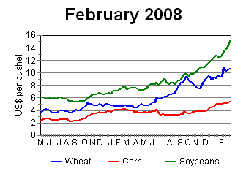
February 2008
Non sense season – time to take a vacation!
Beans in the teens, wheat over $10.00 /bushel in Chicago and double that in Minneapolis
Some saying corn prices need to be higher to buy acres from soya beans for 2008.
Others saying soybean prices need to be higher to buy acres from corn for 2008.
But nothing has really changed from October.

Slide 13
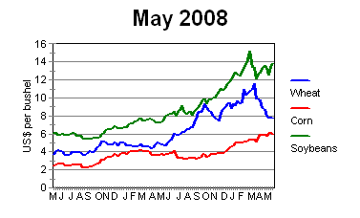
Back to the sanity of weather markets!
Wheat: Again the expectation that global output will be sufficient to meet needs. USDA plus 8%, IGC plus 7%, FAO 9%. No nay sayers yet.
Coarse grains: If US corn area is lost to soybeans as indicated from US prospective plantings survey and perhaps late seeding: feed, ethanol and/or exports will need to be rationed.
Soybeans: Supplies have shrunk so increases in area is needed
Prices: Wheat reflects expectation of improved supplies. Corn and soybeans are still competing.

Slide 14
May 2008 Global S & D’s
M tonnes Output Supply Trade Use Ending stocks
Wheat
2007/08(Est.) 606.4 730.5 109.6 620.4 110.0
2008/09(Proj.) 656.0 766.0 117.5 642.0 124.0
Coarse grains
2007/08(Est.) 1,067.1 1,201.9 125.7 1,067.0 135.0
2008/09(Proj.) 1,070.6 1,205.6 119.3 1,078.4 127.2
Oilseeds
2007/08(Est.) 390.8 463.8 88.5 341.7 56.7
2008/09(Proj.) 423.0 479.7
Source: USDA

Slide 15
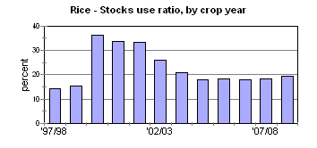
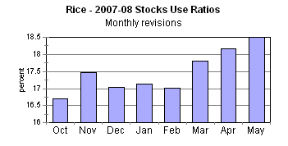
About Rice
The market does not make sense to me.
Therefore, I don’t understand it.
But political perceptions are reality.
And even Walmart rationed customers

Slide 16
Looking forward
Food costs and Bio Fuels
US Renewal Fuels in a political context
Renewable Fuel Alternatives
US Political tea leaves
Policy options for Exporters
!972 Revisited

Slide 17
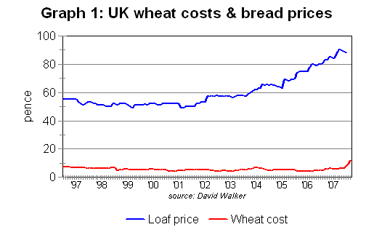
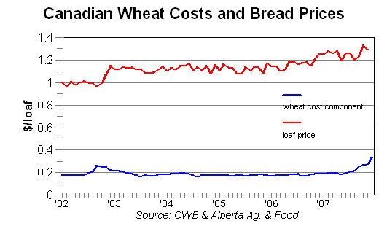
Food Cost and Bio Fuel Debate
Has the use of grain and oilseeds for fuel resulted in higher food prices?
- Probably not much yet. The big move in wheat prices was related to short crops, corn prices have only recently started to rise.
- And other things than wheat prices, like energy and competition, seem to be at play .

Slide 18
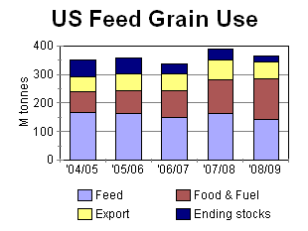
Food Cost and Bio Fuel Debate
Will the use of grain for ethanol result in higher food prices?
- Almost certainly, if the politicians let it
- US feed grain use projected to decline this year
- By the fourth quarter US meat production is expected to start declining on a year -on-year basis.

Slide 19
US Renewable Fuels,
Political Pluses
Energy Security
Environment - clean air
Rural Development
Farm Income support
Energy Conservation

Slide 20
Renewal Fuel Alternatives
Sugar - Brazil and elsewhere
Vegetable Oil - bio diesel, German specialty
Grain Starch - US maize ethanol and others
Cellulose - “Brigadoon” technology

Slide 21
The political tea leaves
March 9, 2007: In Brazil, Bush announces ethanol deal
February 20, 2008: USDA Secretary Ed Schafer Says Renewable Fuels Boost Food Prices
April 25, 2008: Texas Gov Requests Waiver From Renewable Fuels Mandate [Connecticut follows].
April 29 2008: U.S. Secretary of State Condolezza Rice - Biofuels Output May Contribute To High Food Prices
May 19 2008: Bush Administration Opposes Extending Ethanol Tariff

Slide 22
Political Options
US – embargoes, Afghan/Soviet and soya bean experiences
US - lower import tariff on sugar ethanol
EU - re-impose export “taxes”
FSU and Argentina already in the game
Canada’s central selling agency

Slide 23
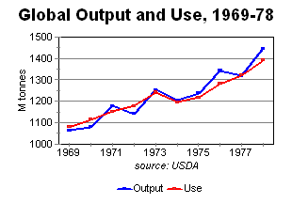
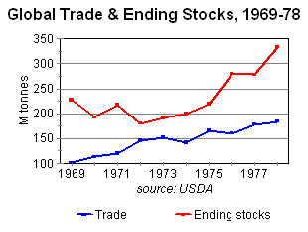
1972 Revisited
Beyond the range of previous experience
The Supreme Soviet’s contribution
Even a drought in Australia
Tight supply short lived with supply response
Nice lift in trade
Comparing the Moscow and Washington decisions

Slide 24
Odd thoughts
Trade and tight grain and oilseed markets
Trade with high freight costs
Regionalised trade
Seasonality of cargoes

Slide 25
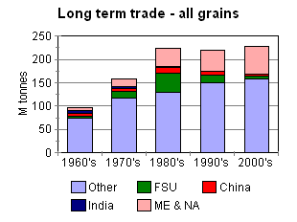
Long term grain trade trends
Includes other than sea borne
Very diverse cargo destinations - top 11 wheat importer less than 50 percent of trade
1960's India, China, FSU and ME & NA less than 20 percent
1970's FSU and ME & NA emerging, India declining
1980's Growth in FSU and ME & NA continues, China occasional big importer
1990's Growth in ME & NA offsets decline in FSU
2000's Ditto with FSU on the other side of the ledger

Slide 26
Conclusions
Political intervention prompted by rising food costs is likely to slow development of US ethanol production.
This may take the form of lower import tariffs on ethanol encouraging offshore sugar ethanol supply.
Other jurisdictions may take similar action, and already have in the more general context of rising food prices.
Bio-fuels are, therefore, probably not the threat to bulk trade that they may appear to be.
Growth in trade in grain and oilseeds may, however, be restricted in the short term.
But current incentive prices are most likely to result in a global supply response.
Growth in world trade will thereafter resume, driven in the main by demand from the Middle East and North Africa.

